Slide 1
SNWA GOES DCS Report
By Chris Ashinhurst
Southern Nevada Water Authority

Slide 2
SNWA/LVVWD
LVVWD
Municipal water provider for the city of Las Vegas.
SNWA
Water purveyor for Southern Nevada
Process and treat more than 400,000 ac-ft through treatment and return flow credits.
Alternative water resources due to drought on CR.
Spring Valley
DDC Valleys

Slide 3
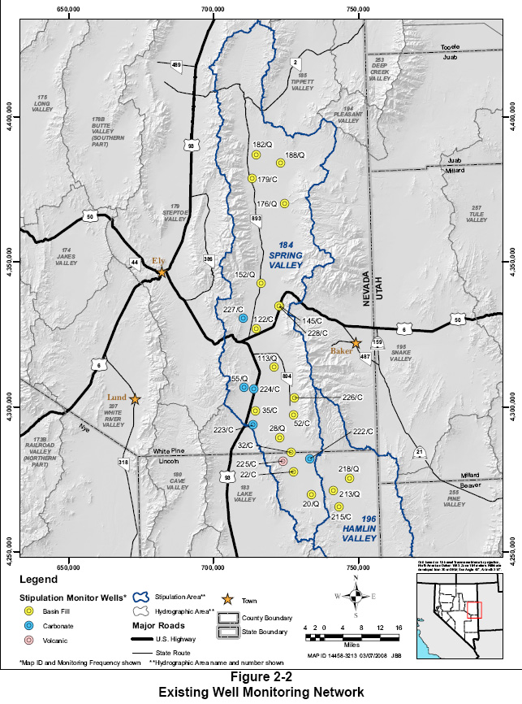

Slide 4
Stations
GOES Transmitters
1x Surface Water
2x Groundwater
Outstations (Transmitting data to GOES stations)
1x Surface Water
1x Groundwater
2x Precipitation
Not Yet Transmitting (Possible Future)
40+ Groundwater
20+ Surface Water
10+ Precipitation
Notes:
Using DAA equipment (Waterlog Xylem YSI)

Slide 5
Telemetry Equipment

Slide 6
Performance
Installed GOES transmitters initially Summer 2013
300 baud CS2
Generally very good. Only minimal data outages.
Issues
User Error Generally
Too much data
Data logger clock settings.

Slide 7
Future Work
Irrigation Wells
Flow
Water Level
Well head pressure.
Remote location wells for background water-level monitoring.

